Slide 1
Phoenix 3U CubeSat
A pREsentation by Ethan cruz

Slide 2
Abstract
2
Fully undergrad led project spread over the course of the 2018-2019 school year
Developing a 3U CubeSat to deploy in Low Earth Orbit (LEO) and capture thermal image data from U.S. cities
Data will help further understanding of consequences related to urban heating and global warming catalysts
CubeSat development team is in the final building/design phase as of April 2019

Slide 3
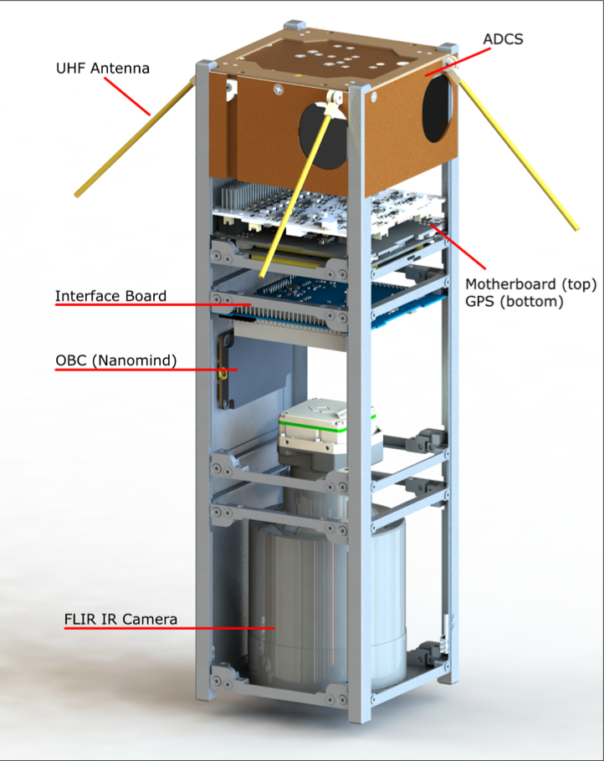
Equipped with Flir tau 2 longwave IR camera,
35 x 44 km ground footprint.
advanced attitude control with 3-axis magnetometer and earth horizon sensors
On board computer designed and built for space flight
super high frequency downlink and Ultra high frequency uplink through uhf antenna
Phoenix system architecture

Slide 4
Systems overview
4
FLIR Tau 2 Long wave IR camera
    Large ground footprint, 68m per pixel (best), captured spectral band ranging from 7.5 - 13.5 m
Attitude control: MAI-400 ADCS
    3 axis magnetometer, EHS, compact design (10 x 10 x 5cm) providing accurate telemetry
On board computer: NanoMind A3200
    Highly miniaturized, utilizes common serial communication interfaces, designed for space conditions
Antenna and communications
    Downlink over ammeter s-band (~2.45 GHz), uplink on UHF amateur bands (420-450 MHz), utilizes OEM615 GNSS receiver
$$μ$$

Slide 5
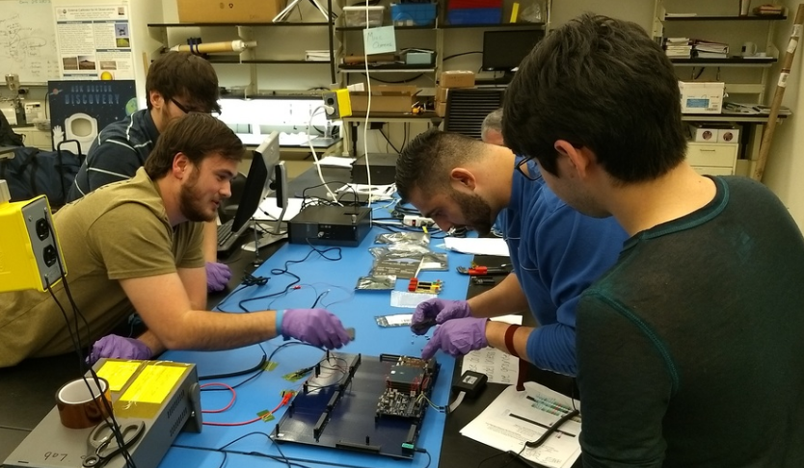
Phase one: Design, Integration, and engineering
5
Frame design and EPS fitting
Flight software development
Payload calibration/Thermal control
System testing for flight readiness
Early CubeSat Layout

Slide 6
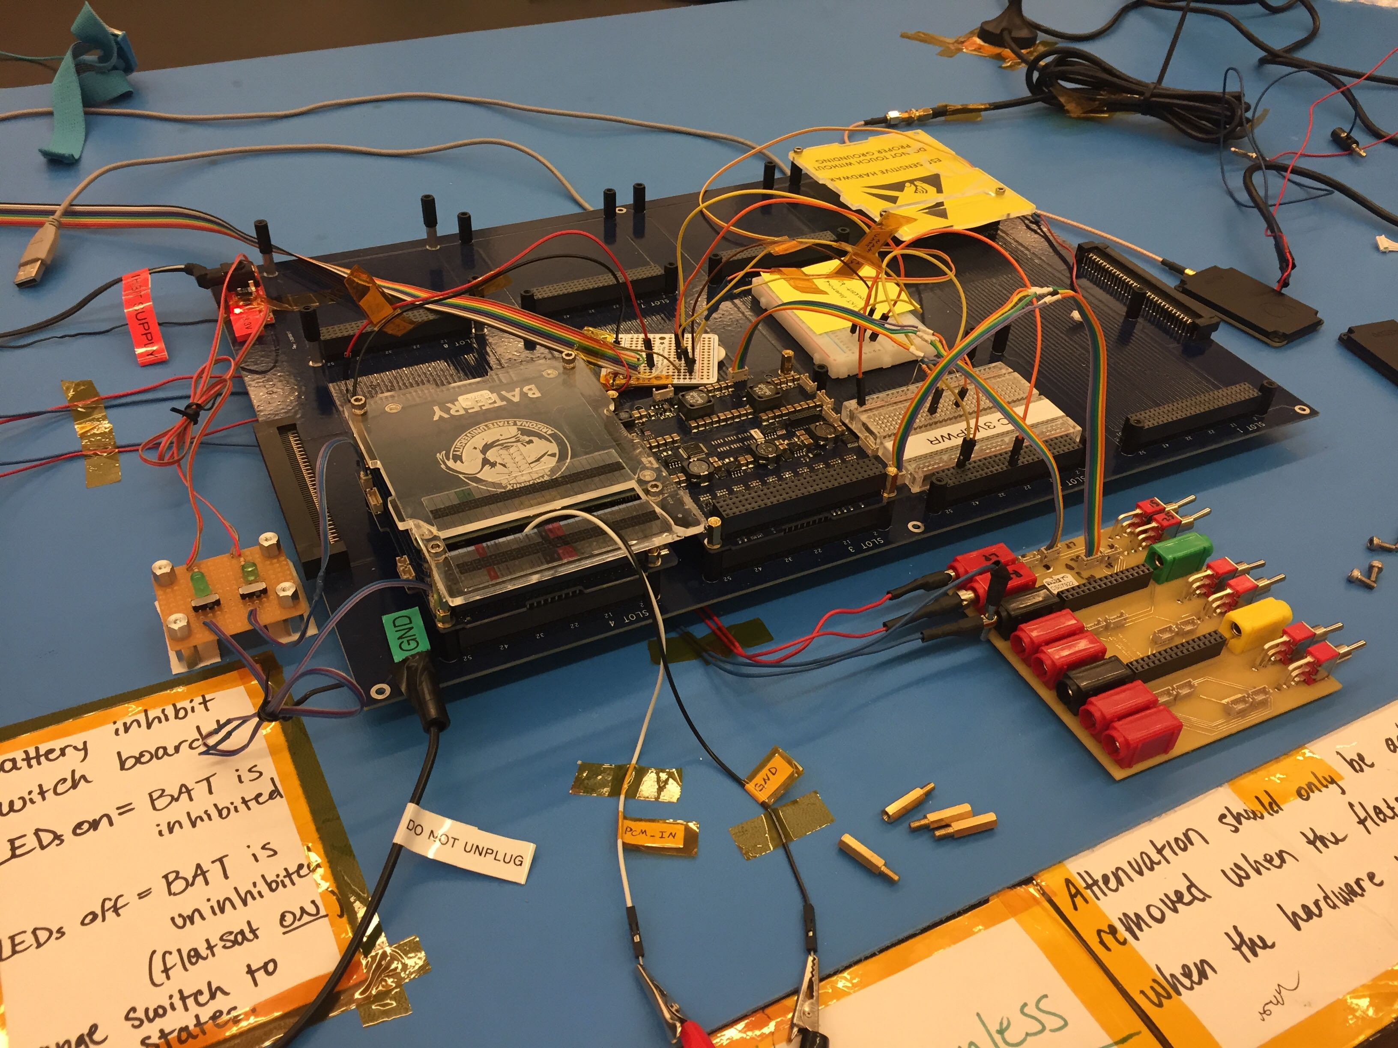
Phase TWO: Preliminary testing and data recording
6
Correctly writing to data storage
Communication between devices
Correct readings from instruments
Move from prototype to final
Testing the solar array on flatsat dev. board

Slide 7
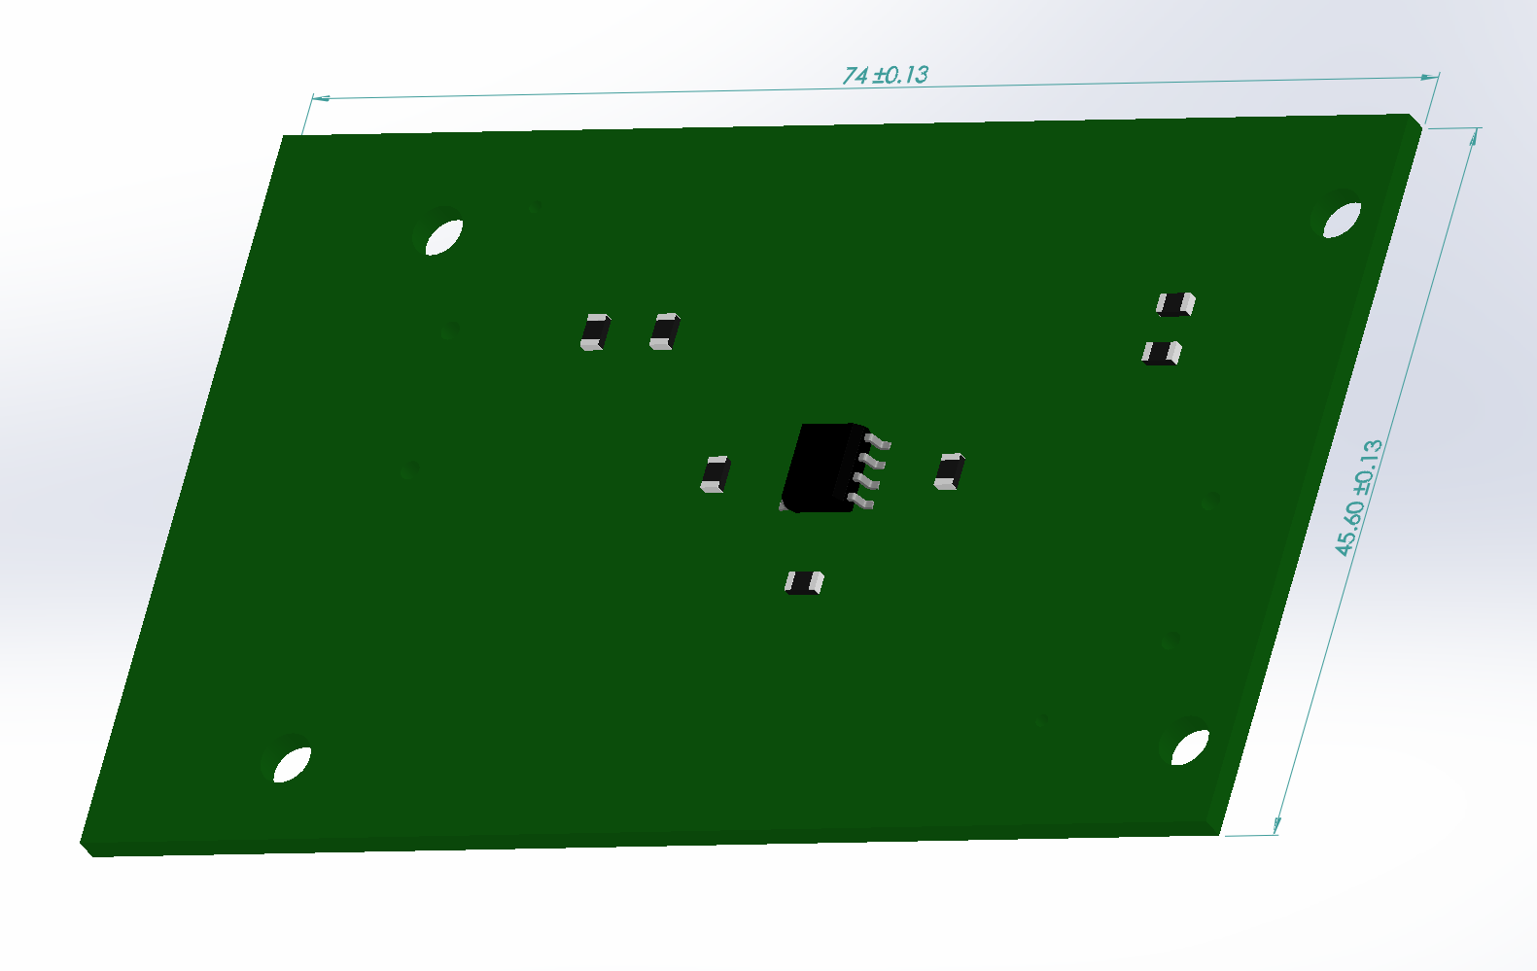
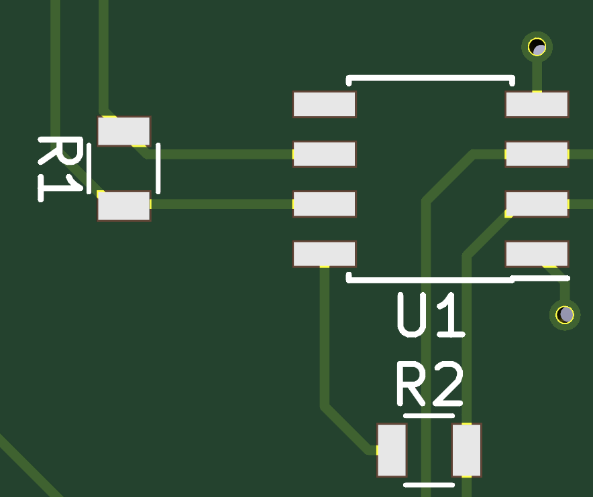
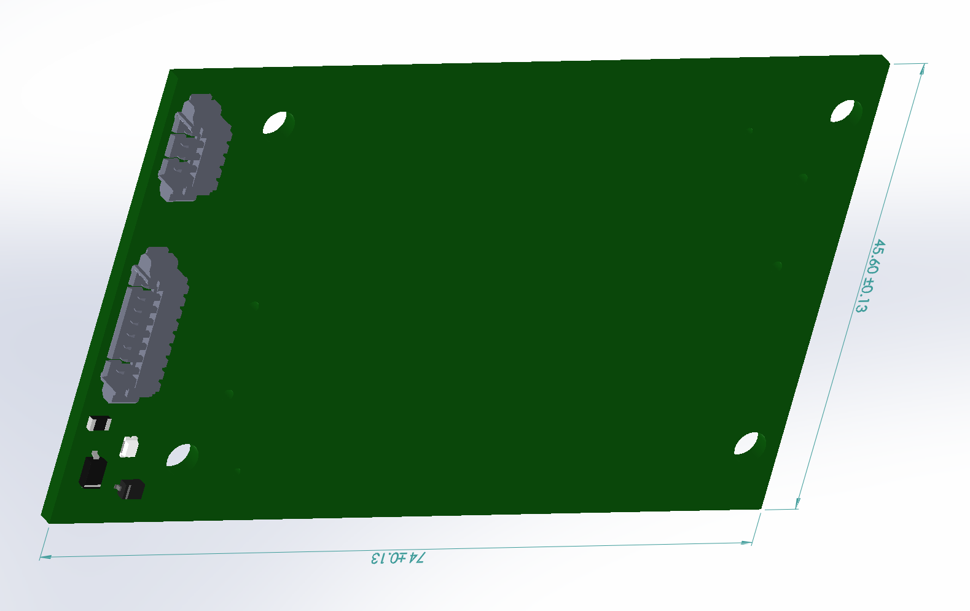


Slide 8
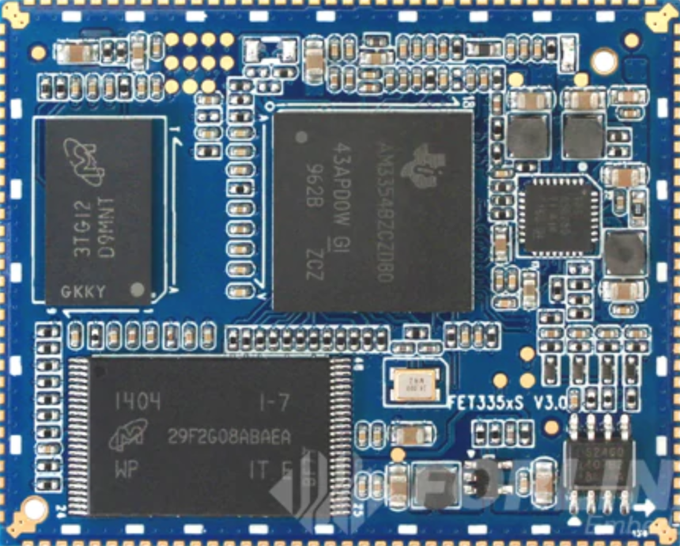
FET335xS-II System on module (forlinx)
8
Compact, lightweight model designed for automotive/aerospace applications
Similar to micro controller/compact computer board without extra peripherals
Low power (0.75 - 1W) while providing accurate data and signal processing (1GHz max)
FET335xS-II SoM development board (Forlinx)

Slide 9

Phase Three: Finalizing design and launch
9
Phoenix CubeSat will be sent to Wallops Flight Facility, VA. after the product is built
Estimated two years in LEO orbit
Receiving heat flux data, converting to temperature to map heat island
Discoveries lead to solutions for pressing issues regarding climate and sustainable living
Two stage orbital rocket developed by Rocket Lab launching 13 cubesats into orbit

Slide 10

Waste heat is generated from expending energy into the development of land
Furthering our understanding
As population continues to grow in phoenix, the data tends to show an increase in temperature
Cubesat technology can help receive and interpret real time data to help mitigate further climate issues
Having reliable data for present and future interpretation helps build and maintain a sustainable society

Slide 11
Thank you

